Slide 1
Where Are Chicagoans Going?
Diarra Fall – DDA9

Slide 2
Agenda
Context
Data
Findings
Recommendations
Further Study
Questions

Slide 3
Context

Slide 4

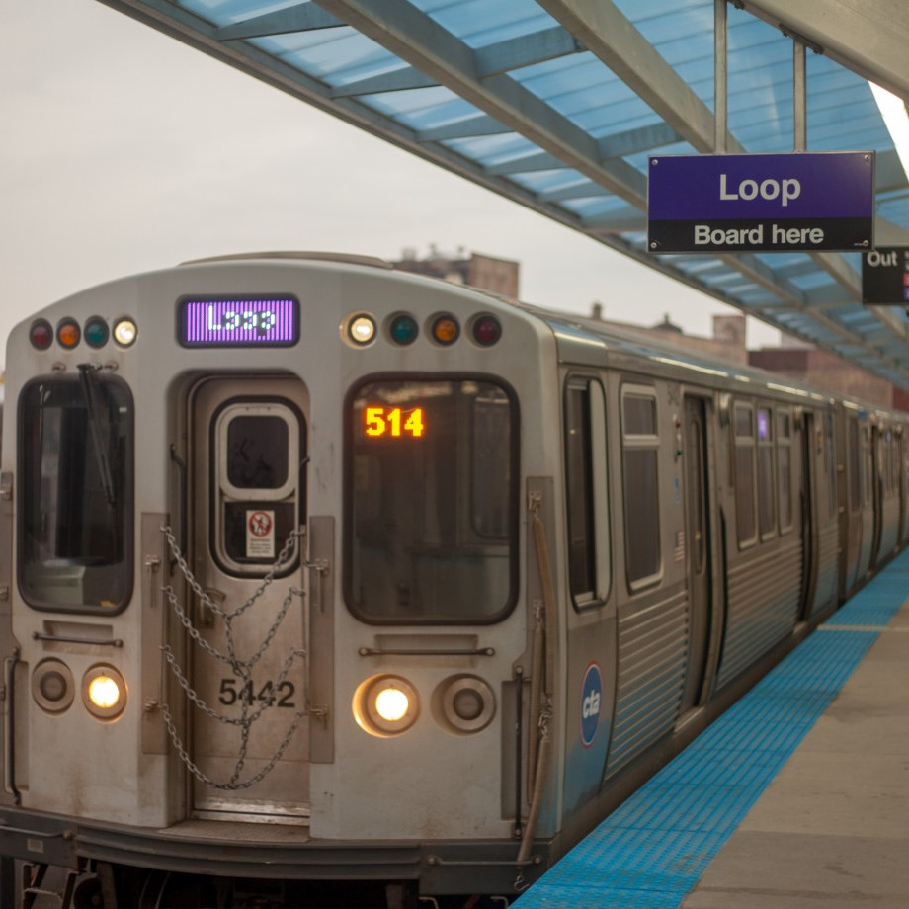
Chicago Transportation Stats
~2.7 million residents in Chicago
The nation’s second largest public transportation system (L-Rail + Buses)
Commuter Rail (Metra)
6,382,425 documented taxi trips in 2022
69,109,780 documented rideshare trips in 2022
5,667,717 documented rental bicycle trips in 2022
Notes:
The census bureau estimates that there are 2.7 million people living in Chicago

Slide 5
Data

Slide 6
Where did the data come from?
What trips were considered?
Rental Bicycle Data from Divvy
Chicago’s Open Data Site
Private Transportation Datasets:
Transportation Network Providers (Rideshare)
Taxis
Public Transportation Datasets:
Bus Routes
Bus Stops
L-Rail Lines
L-Rail Stations
Metra Lines
Metra Stations
Zip Code Boundaries
Beginning in 2022
Over 2 Miles
Under 1 Day
Between Zip Codes

Slide 7
Findings
Click Here to See the Dashboard!

Slide 8
Recommendations

Slide 9
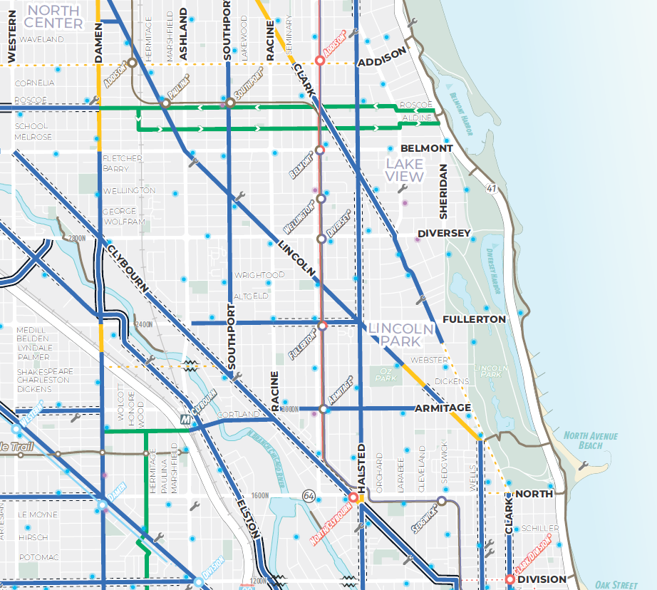
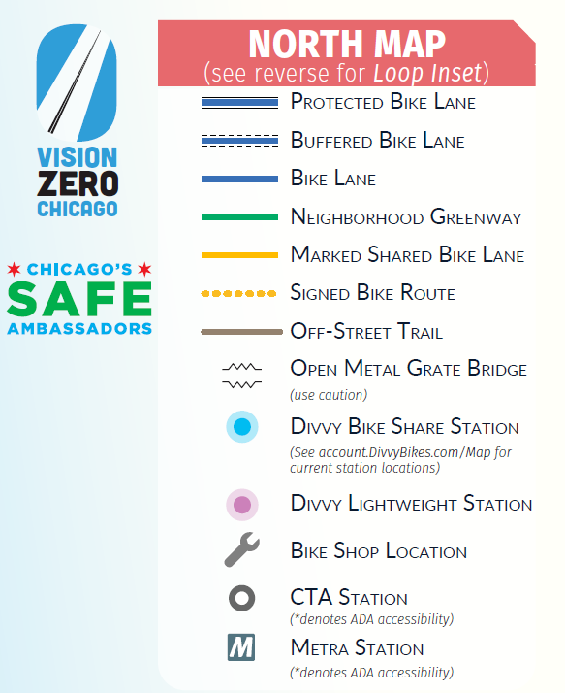
Cycling
More protected bike lanes in zip codes that are likely to be biked between
Source: 2022 Chicago Bike Map
https://40f4ba.a2cdn1.secureserver.net/wp-content/uploads/2022/05/2022_Chicago-Bike-Map.pdf

Slide 10
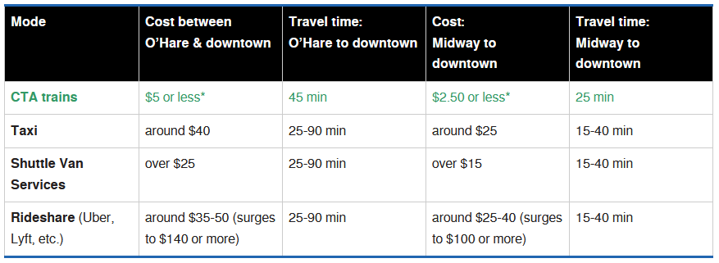
Airport Transit
A bus route from the airport into downtown
Source: Chicago Transit Authority
https://www.transitchicago.com/airports/

Slide 11
Further Study

Slide 12
Additional Data for Consideration
Ridership data from public transportation
Time of day
Trips within the same zip code
Demographic data

Slide 13
Acknowledgements
I’d like to send a huge thank you to my instructors:
Chris Wright
Monica Weiss-Sharp
Sobiya Uddin

Slide 14
Questions?
Diarra Fall
Diarra.fall@outlook.com
More About Me
linkedin.com/in/diarrafall/
More About this Project
github.com/diarra-fall

